Slide 1

DEBUGGING
CHAPTER 24

Slide 2
Topics
Getting Started with Debugging
Types of Bugs
  Compile-Time Bugs
  Bugs Attaching Scripts
  Runtime Errors
Stepping Through Code with the Debugger
  Attaching the Debugger to Unity
Watching Variables in the Debugger

Slide 3
Getting Started with Debugging
Debugging is a way to step through and watch your code as it is running
This can help you
  Better understand code
  Find errors and bugs
  Track down inefficiencies
Debugging is built in to Unity via MonoDevelop
  The MonoDevelop debugger can attach to the Unity process to debug your code
  And, the MonoDevelop debugger can connect to an iOS or Android device and debug code running on the device!!!
    This is very helpful for finding issues with touch interfaces
    Can be done over either a cable or WiFi!
  The book has detailed instructions for using the debugger

Slide 4
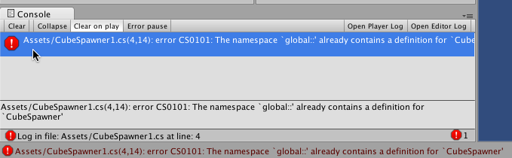
Types of Bugs
Compile-Time Bugs
  A bug found in the syntax of your code
  Compile-time bugs prevent your code from compiling
    Makes it unusable in Unity until the bug is resolved
  Compile-time bugs usually cause very specific errors
    The error below is on line 4, character 14 of CubeSpawner1.cs

Slide 5
Anatomy of a Compile-Time Bug
Click the error message to get more information

Slide 6
Anatomy of a Compile-Time Bug
Click the error message to get more information
The full error text can usually tell you what's wrong

Slide 7
Anatomy of a Compile-Time Bug
Click the error message to get more information
The full error text can usually tell you what's wrong
  If not, search the Internet for the error number
  Example: "Unity error CS0101"
    Unity forums and StackOverflow.com have some of the best answers

Slide 8
Common Compile-Time Errors to Know
error CS0101: The namespace 'global::' already contains a definition for '______'
  Two scripts are trying to define the same class
    Change the name of the class in one of the scripts
error CS1525: Unexpected symbol '}'
  Many "Unexpected symbol" errors are caused by a semicolon missing on a previous line or a misplaced brace
    Check line endings for semicolons ;
    Check to make sure all braces have a mate { }

Slide 9
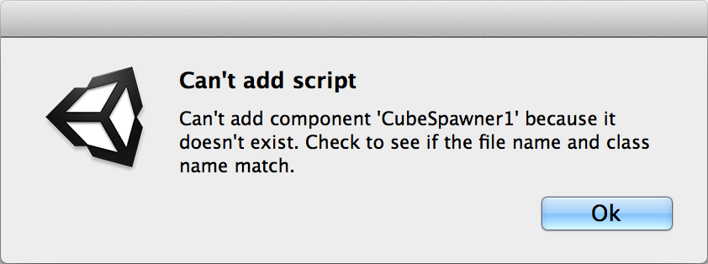
Bugs Attaching Scripts to GameObjects
Error occurs when attempting to attach a script to a GameObject
  Caused by the name of the script not matching the name of the defined class
Example
  Script filename: CubeSpawner1 (or CubeSpawner1.cs)
  Class name: public class CubeSpawner : MonoBehaviour { … }
To Fix: Match the names to each other

Slide 10
Types of Bugs
Runtime Errors
  A bug that occurs when your code is running
  Unity has no way of predicting these
Most common types of Runtime Errors
  UnassignedReferenceException
  NullReferenceException

Slide 11
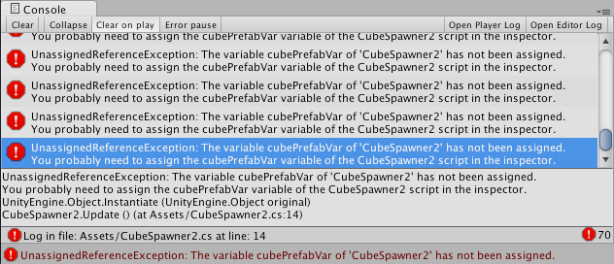
Common Runtime Errors
UnassignedReferenceException
  A variable in the Inspector has not been set
    Most commonly GameObject prefabs for Instantiate() calls
  To Fix: Assign the variable in the Inspector

Slide 12
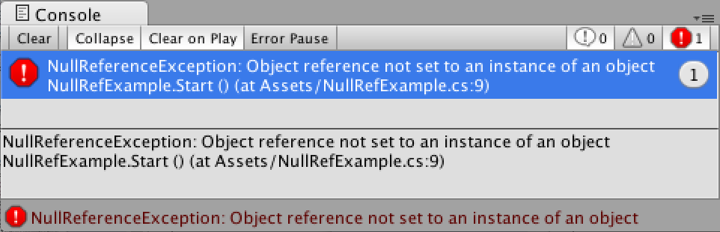
Common Runtime Errors
Null Reference Exception
  Unity has been asked to access something that doesn't exist
  Example:
        7 void Start () {
        8 GameObject[] goArray = new GameObject[10];
        9 print (goArray[5].transform.position);
        10 } // on line 9, goArray[5] is null, so it has no transform
    Error can only tell you the line number
    These are difficult to debug!

Slide 13
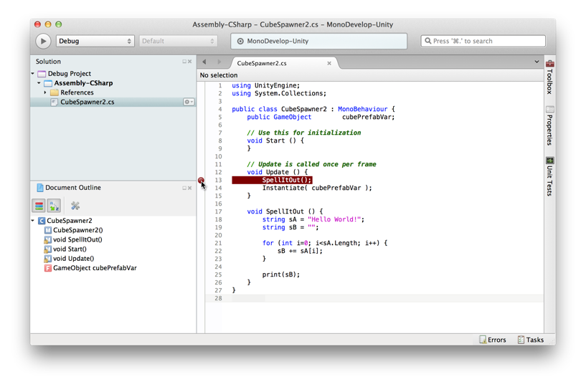
Stepping Through Code with the Debugger
Step 1: Set a Breakpoint in your code

Slide 14
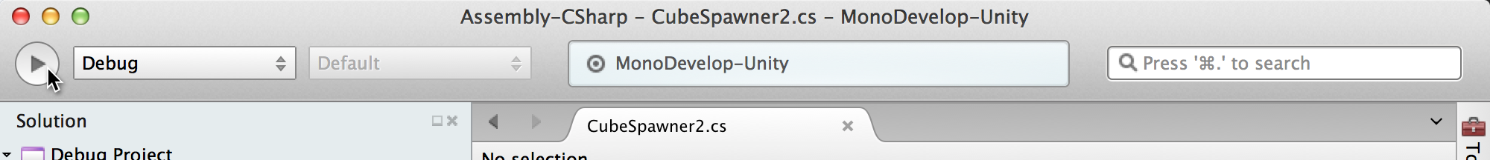
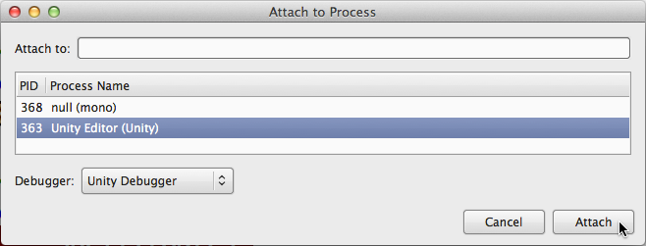
Stepping Through Code with the Debugger
Step 2: Attach the Debugger to the Unity process
  Much more detail in the book (about a potential bug)
  Click the Attach to Process button in MonoDevelop
    Choose Unity Editor (Unity) from the process list & click Attach

Slide 15
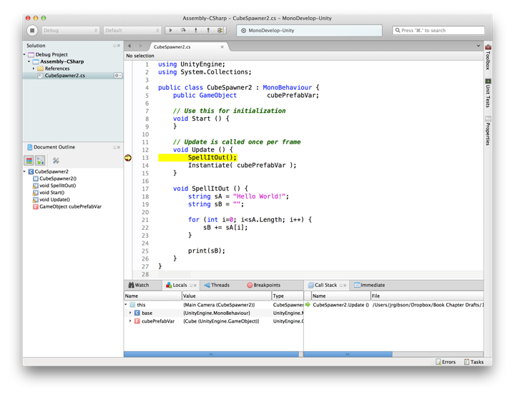
Stepping Through Code with the Debugger
Step 3: Click Play in Unity
  The Debugger will halt code execution at the Breakpoint

Slide 16
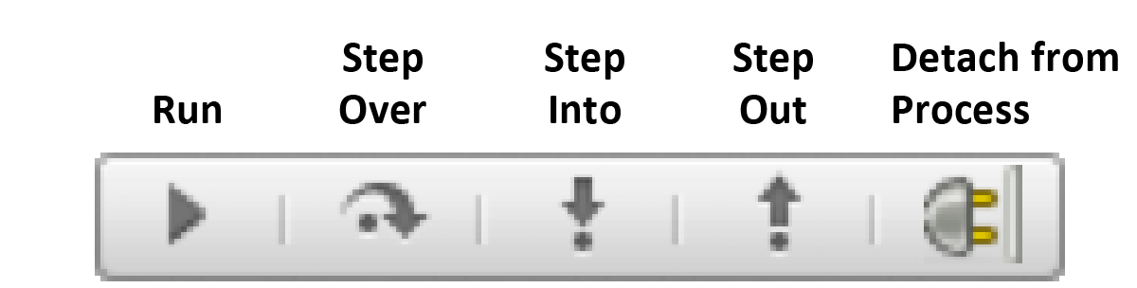
Stepping Through Code with the Debugger
Step 3: Click Play in Unity
  The Debugger will halt code execution at the Breakpoint
  Unity will be completely frozen while the Debugger is halted
    This means you cannot switch back to the Unity process
  Important buttons at the top of the Debugger window
    Each controls the Debugger's execution
      Run – Continues playing the project until another breakpoint is hit
        If Run doesn't advance to the next frame, switch back to Unity
      Step Over – Continues to the next line, stepping over function calls
      Step In – Continues to the next line, stepping into function calls
      Step Out – Exits the current function but continues debugging
      Detach Process – Stops debugging altogether

Slide 17
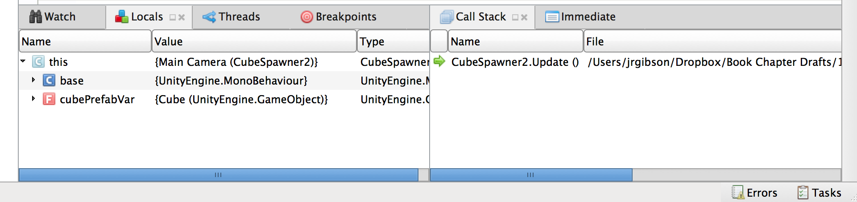
Watching Variables in the Debugger
Panes at the bottom of MonoDevelop have more info
  Locals - Allows you to see all local variables
    this is a reference to the current class instance
  Watch - Allows you to enter specific variables to watch
  Call Stack - Shows you which functions have been called to get to this point in the code
    Click a function to jump to it's local scope

Slide 18
Chapter 24 – Summary
Debugging is one of the most important processes in coding
  The MonoDevelop Debugger is one of the most powerful tools for you to learn
  It's also surprisingly easy to learn to use
  The Debugger can also help you understand complex code
    Use it on the code from the book if you're ever confused
You can also code for Unity using Microsoft Visual Studio, which has its own debugger
  Lots of information online about how to set this up
Next Chapter: Classes
  Learn about how classes combine data and functionality
  All the code you write in Unity C# will be in classes
  Classes are also the key to Object-Oriented Programming

